Slide 1
O P E R A
Guidelines Webinar
January 2014
Douglas Sonntag
Performing Arts Division Director
Georgianna Paul
Opera Specialist
Apply: http://arts.gov/grants/organizations-apply

Slide 2
What we’ll cover today:
Welcome
Opera Overview
Applying to Art Works
Q & A

Slide 3
Welcome
The National Endowment for the Arts is a public agency dedicated to advancing artistic excellence, creativity, and innovation for the benefit of individuals and communities. The NEA awards grants to arts organizations of all sizes across all 50 states and 6 U.S. territories.

Slide 4
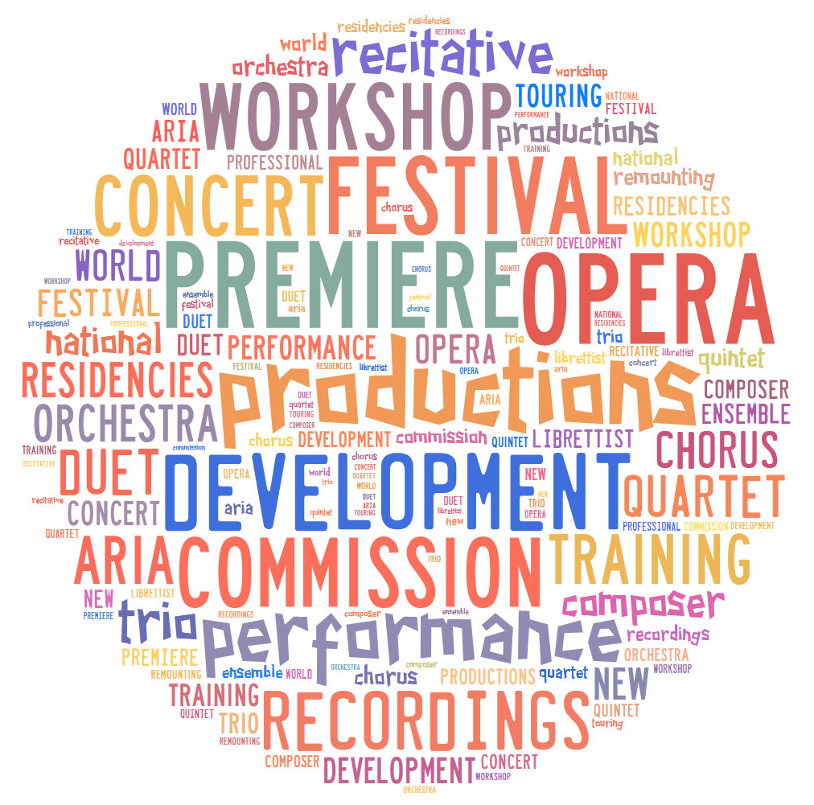
Opera Overview

Slide 5
Opera Overview
Fiscal Year 2013 Opera Statistics
Art Works I
66 Applications Submitted
38 Applications Recommended
$1,140,000 Total Amount Recommended
Art Works II
37 Applications Submitted
22 Applications Recommended
$787,000 Total Amount Recommended
FY13 Total: 60 grants made providing $1,927,000
of support to the opera field

Slide 6
Art Works
Its guiding principles are at the center of everything we do at the NEA, referring to:
The works of art themselves
The ways art works on audiences
Art is work for the artists and arts professionals who make up the field

Slide 7
Art Works Support Four Outcomes:
Projects must align with one of four outcomes:
Creation: The portfolio of American Art is expanded.
Engagement: Americans throughout the nation experience art.
Learning: Americans of all ages acquire knowledge or skills in the arts.
Livability: American communities are strengthened through the arts.

Slide 8
Art Works Encourages Innovation
Innovative projects:
Are likely to prove transformative with the potential for meaningful change
Are distinctive, offering fresh insights and new value for their fields and/or the public through unconventional solutions
Have the potential to be shared and/or emulated, or are likely to lead to other advances in the field

Slide 9
Art Works supports projects in many disciplines:
Artist Communities
Arts Education
Dance
Design
Folk & Traditional Arts
Literature
Local Arts Agencies
Media Arts
Museums
Music
Opera
Presenting & Multidisciplinary Works
Theater & Musical Theater
Visual Arts

Slide 10
Requirements:
Eligible applicants are:
Nonprofit, tax-exempt 501(c)(3), U.S. organizations
Units of state or local government
Federally recognized tribal communities or tribes
Eligible applicants must:
Have a three-year history of programming
Meet reporting requirements on any previous NEA awards

Slide 11
Application Limits:
Organizations may submit only one application under the Art Works guidelines, with limited exceptions such as:
Parent (and Related) Organizations
Applicants to Media Arts (July deadline)
Applications to another category such as Our Town
See the guidelines for other information on application limits

Slide 12
Grant Amounts:
Grant requests range from $10,000 to $100,000
No grants will be made for less than $10,000
One-to-one match required for project budget
OPERA grants range from $10,000 to $100,000

Slide 13
The NEA Does Not Fund:
General operating expenses
Seasonal support
Individuals
Individual schools
Facility construction, purchase, or renovation
Commercial, for-profit enterprises
Creation of new organizations
Academic degrees
Re-granting
Projects that replace arts instruction provided by a classroom teacher or an arts specialist in schools

Slide 14
Grant Review Process:
Step 1: Panel Review
Step 2: National Council on the Arts
Step 3: NEA Chairman
Review Criteria:
Artistic Excellence
Artistic Merit

Slide 15
Art Works Processing Timeline:
Art Works I Art Works II
Application Deadline: | February 20, 2014 | July 24, 2014
NEA-GO Upload: | March 6-20, 2014 | August 7-21, 2014
Panel Review: | Summer 2014 | Fall 2014
National Council on the Arts Review: | October 2014 | March 2015
Notification: | November 2014 | April 2015
Earliest Project Start Date: | January 1, 2015 | June 1, 2015

Slide 16
February 20, 2014 NEA Application Deadline Project start date must be on/after January 1, 2015
Creation
Commissions, residencies, workshops, development, and performances of new work
Development of innovative new works that cross genres
Engagement
Premieres: world, national, regional, and local
New productions: traditional and contemporary works
Existing productions: remounting productions
Concert opera: performances that are not fully staged
Notes:
Re: concert opera …
“Music organizations (non-opera organizations) that are proposing concert opera projects should apply under the Music discipline. If you are considering a concert opera project, contact Opera or Music staff before preparing an application.”

Slide 17
July 24, 2014 Deadline NEA Application Deadline Projects start date must be on/after June 1, 2015
Creation
Opera festivals - new work: commission, residency, workshop, development, performance
Engagement
Opera festivals – premieres (world, national, regional, local); new and existing productions
Domestic touring and outreach activities
Artist residency activities
Technology projects: simulcast performances; recordings; online resources which provide public access to operatic works
Documentation, preservation, conservation, and archival projects
Services to the opera field -- opera companies, singers, composers, librettists
Learning
Education activities -- youth, adults, intergenerational groups, schools
Professional development programs for artists
Livability*
Operatic performances in public spaces to foster community interaction or enhance community.
* Applicants are strongly encouraged to contact staff if considering Livability as an outcome

Slide 18
How to Apply
Find our guidelines
online at:
arts.gov
in the
“Apply for a Grant”
Section.

Slide 19
How to Apply
Select
“Grants to Organizations”

Slide 20
How to Apply
Select
“Art Works”
to learn more about the category.
Browse through “Key Information for Applicants”
for other important information.

Slide 21
How to Apply
After you read about the
Art Works category,
select Opera
to apply.

Slide 22
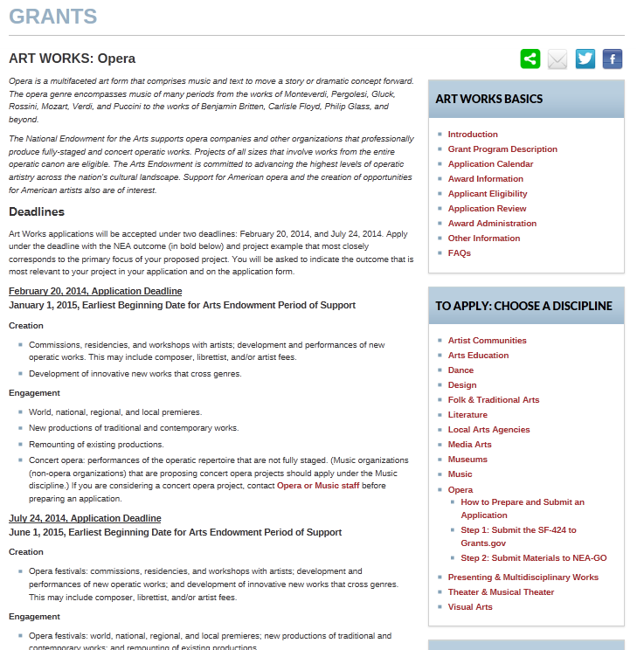
How to Apply
Read about the project types supported at each deadline.
Then select “How to Prepare and Submit an Application” as well as the instructions to get started.

Slide 23
How to Apply
Step 1 of 2:
Submit through Grants.gov
(for Art Works I: February 20 deadline*, OR
for Art Works II: July 24 deadline*):
SF-424 (Application for Federal Domestic Assistance)
This is the only item you submit through Grants.gov.
If it is not successfully submitted by the deadline you will be unable to submit your other materials in NEA-GO.
*Remember to submit your NEA application at least 10 days prior to the NEA application deadline.

Slide 24
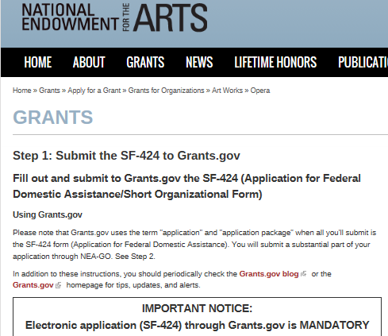
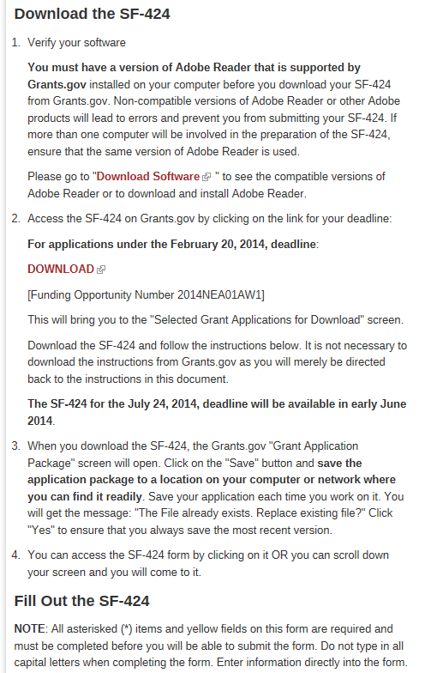

Slide 26
About Grants.gov

Slide 27
About Grants.gov
Grants.gov is an online, government-wide electronic application system through which all applicants must submit their applications.
For first time registration, allow up to 14 days.
You are required to change your password every 60 days.
See www.grants.gov for more details or call 1-800-518-4726.
To use Grants.gov, first obtain a DUNS number, register with SAM (System for Award Management), and allow at least 2 weeks for registration or renewal.
Must renew SAM information annually.
Details: www.SAM.gov; 1-866-606-8220

Slide 28
How to Apply
Step 2 of 2:
Submit application contents via the NEA Grants Online System (aka NEA-GO)
(for Art Works I, March 6 - 20, 2014;
for Art Works II, August 7 - 21, 2014):
NEA Grant Application Form (including answers to narrative questions, financial info, bios)
Items to Upload (Programmatic activities list, statements of support, special items, and work samples)

Slide 29
NEA GrantsOnline™ System (NEA-GO)
You will submit the Grant Application Form and electronically upload other items using the NEA-GO system two weeks after your Grants.gov application deadline.
Prepare these materials well in advance of the application deadline and have them ready to upload once NEA-GO becomes available to you.

Slide 30
NEA GrantsOnline™ System (NEA-GO)
Accessing the system:
Go to “Track My Application” at Grants.gov
The notes box will have a link to NEA-GO and information about when the system will be open
NEA-GO User Name = Grants.gov Tracking Number
NEA-GO Password = NEA Application Number
This information is available 2 days after you submit your SF-424 to Grants.gov (but no earlier than 10 days before the NEA application deadline).

Slide 31
Grants.gov “Track My Application”

Slide 32
NEA-GO (NEA Grants Online)

Slide 33
Application Tips
Please read the guidelines carefully
Be aware of the new application deadlines
The NEA does not fund general operating or seasonal support.
Your project should be a distinct selection of your annual programming activities and not cover the entirety of your seasonal offerings.
The only exception is for organizations that undertake only one activity per year, such as a festival.

Slide 34
Application Tips
BE SPECIFIC
Apply for different phases of a project (e.g. commission, development, workshop, premiere, performance).
Be clear about the planned project activities.
An indication of repertoire to be programmed is an important part of review.
Don’t assume the panel is familiar with the work of your organization
List artists under consideration if artists are not yet confirmed

Slide 35
Application Tips
CHOOSE COMPELLING WORK SAMPLES
Work samples are a vital part of your proposal.
Selections should relate as directly as possible to your proposed project.
Selections should be of recent recordings (within the past two years). Check the guidelines for requirements.
Selections should include examples of previous similar activities, proposed artists, and works to be performed or presented.

Slide 36
Application Tips
Choosing the correct discipline
Apply to the discipline that is most closely aligned with your proposed project.
PRESENTING & MULTIDISCIPLINARY WORKS: Single discipline presenting projects should apply to that discipline
SHOULD MY PROJECT BE SUBMITTED TO OPERA OR ARTS EDUCATION?
Apply to OPERA if your project:
Comprises short-term arts exposure, arts appreciation, or intergenerational activity
Apply to Arts Education if your project:
Comprises in-depth, curriculum-based arts education for youth (ages 5-18), and
Aligns with national/state arts education standards,
or is for professional development of teachers or teaching artists and education or community leaders
February deadline = Community-based projects
July deadline = School-based projects
Contact Denise Brandenburg, 202-682-5044 or brandenburg@arts.gov

Slide 37
Application Tips
contact staff to receive panel feedback and advice.
Specialists are available to give you detailed panelist feedback.
Helpful for all applicants to improve future applications.
Additionally, staff is available for guidance before you submit an application.

Slide 38
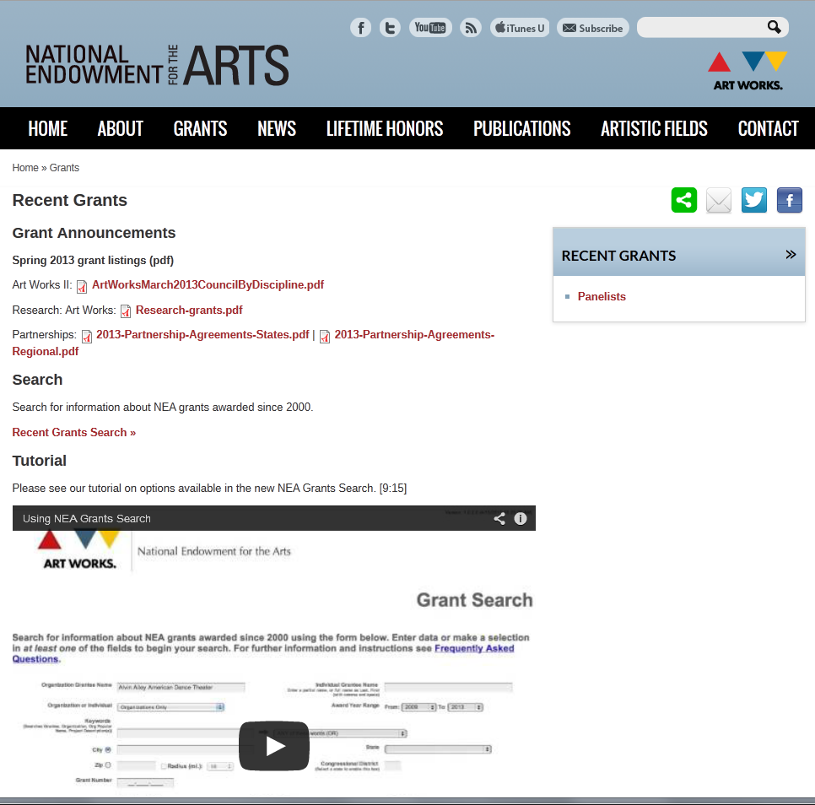
FAQs & Past Grants

Slide 39
Sample Applications
Examples of previously submitted application narratives can be found in our FOIA Reading Room at www.arts.gov.

Slide 40
Accessibility
Things to consider when planning your project:
Sign interpretation of panels or community workshops, upon request
Accessible electronic versions of print material and publications, upon request
Wheelchair accessible venues
Large-print, high contrast labeling of exhibitions
Open or closed captioning of broadcasts and educational videos
Contact the NEA’s Office of Accessibility for further guidance

Slide 41
Reminder: New This Year!
Deadlines have changed
Our website (arts.gov) has a new look
Most application materials are now submitted online via NEA-GO; see the “How to Apply” instructions for details
No grants will be made under $10,000
Letters of support are required for ALL applications
Program evaluation resources are available at arts.gov

Slide 42
Questions?
Guidelines are now available at:
http://arts.gov/grants/organizations-apply
For more information contact:
Georgianna Paul
Opera Specialist
202.682.5600
paulg@arts.gov

