Slide 1
Music
Guidelines Webinar
Doug Sonntag, Performing Arts Director
Apply: http://arts.gov/grants/organizations-apply

Slide 2
What we’ll cover today:
Welcome
Music Overview
Applying to Art Works
Q & A

Slide 3
Welcome
The National Endowment for the Arts is a public agency dedicated to advancing artistic excellence, creativity, and innovation for the benefit of individuals and communities. The NEA awards grants to arts organizations of all sizes across all 50 states and 6 U.S. territories.

Slide 4
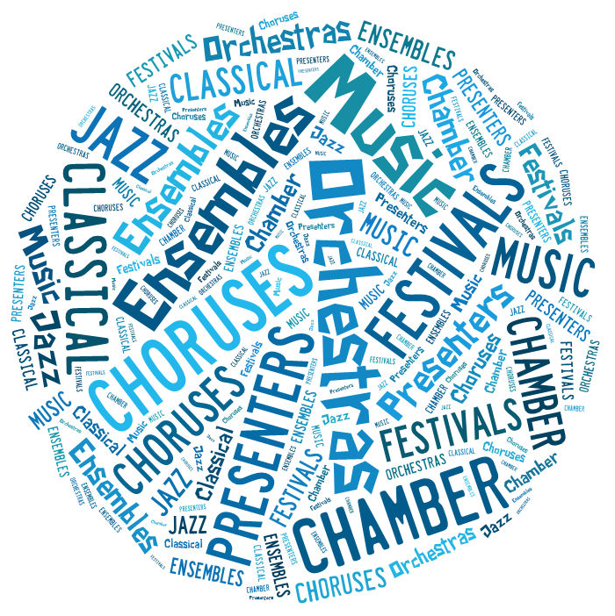
Music Overview

Slide 5
Art Works
Its guiding principles are at the center of everything we do at the NEA, referring to:
The works of art themselves
The ways art works on audiences
Art is work for the artists and arts professionals who make up the field

Slide 6
Art Works Supports Four Outcomes:
Creation: The portfolio of American Art is expanded.
Engagement: Americans throughout the nation experience art.
Learning: Americans of all ages acquire knowledge or skills in the arts.
Livability: American communities are strengthened through the arts.

Slide 7
Art Works Encourages Innovation
Innovative projects:
Are likely to prove transformative with the potential for meaningful change
Are distinctive, offering fresh insights and new value for their fields and/or the public through unconventional solutions
Have the potential to be shared and/or emulated, or are likely to lead to other advances in the field

Slide 8
Art Works supports projects in many disciplines:
Artist Communities Museums
Arts Education Music
Dance Opera
Design Presenting & Multi-
Folk & Traditional Arts disciplinary Works
Literature Theater & Musical
Local Arts Agencies Theater
Media Arts Visual Arts

Slide 9
Requirements:
Eligible applicants are:
Nonprofit, tax-exempt 501(c)(3), U.S. organizations
Units of state or local government
Federally recognized tribal communities or tribes
Three-year history of programming
Meet reporting requirements on any previous NEA awards

Slide 10
Application Limits:
Organizations may submit only one application under the Art Works guidelines, with limited exceptions such as:
Parent (and Related) Organizations
Applicants to Media Arts (July deadline)
Applications to another category such as Our Town
See the guidelines for other information
on application limits

Slide 11
Grant Amounts:
Grant requests range from $10,000 to $100,000
No grants will be made for less than $10,000
One-to-one match required for project budget
Average Music grant amount was $20,000 in FY 2014

Slide 12
We Do Not Fund:
General operating or seasonal support
Individuals
Individual schools
Facility construction, purchase, or renovation
Commercial, for-profit enterprises
Creation of new organizations
Academic degrees
Re-granting
Projects that replace arts instruction provided by a classroom teacher or an arts specialist in schools

Slide 13
Grant Review Process:
Step 1: Panel Review
Step 2: National Council on the Arts
Step 3: NEA Chairman
Review Criteria:
Artistic Excellence and Artistic Merit

Slide 14
Art Works Processing Timeline:
Application Deadline: | February 20, 2014 | July 24, 2014
NEA-GO Upload: | March 6-20, 2014 | August 7-21, 2014
Panel Review: | Summer 2014 | Fall 2014
National Council on the Arts Review: | October 2014 | March 2015
Notification: | November 2014 | April 2015
Earliest Project Start Date: | January 1, 2015 | June 1, 2015

Slide 15
February 20, 2014 Deadline [January 1, 2015 earliest project start date]
Creation
Commissions, residencies, and workshops with artists; development and performances of new works.
Innovative creation of music that draws upon a wide range of contemporary resources, emerging practices, and/or technology.

Slide 16
February 20, 2014 Deadline [January 1, 2015 earliest project start date]
Engagement
Premieres, performances, and presentation of new musical works.
Public presentations and performances of artistically excellent works.
Performance and educational engagements by NEA Jazz Masters that honor their bodies of work, history, or style; provide understanding of their significance to jazz; and broaden audience awareness of the original American art form.
Innovative musical presentations that juxtapose disparate works or genres and engender new connections.
Residency activities where the primary purpose is public engagement with art.
Services that reach a broad constituency of music organizations, musicians, music educators, and administrators. This may include workshops, conferences, publications, professional development, technical assistance, networks, or online resources.

Slide 17
February 20, 2014 Deadline [January 1, 2015 earliest project start date]
Learning
Professional artistic development and training programs for musicians such as conducting, mentorship, and career development.

Slide 18
July 24, 2014 Deadline [June 1, 2015 earliest project start date]
Engagement
Domestic touring.
Outreach projects that involve diverse communities or that reach new audiences.
Recordings of works by American composers.
Technology projects such as online resources which provide public access to musical works.
Documentation, preservation, and archival projects.
Learning
Education and related activities for youth, adults, intergenerational groups, and schools.
Livability
Music festivals, performances, and other activities in public spaces that are intended to foster community interaction and/or enhance the unique characteristics of a community.
(Applicants are strongly encouraged to contact staff if they are considering Livability as a primary outcome.)

Slide 19
How to Apply
Find our guidelines
online at:
arts.gov
in the “Apply for
a Grant” Section.

Slide 20
How to Apply
Select “Grants to Organizations.”

Slide 21
How to Apply
Select
“Art Works”
to learn more about the category.
Browse through “Key Information for Applicants” for other important information.

Slide 22
How to Apply
After you read about the Art Works category, select Music to apply.

Slide 23
How to Apply
Read about the project types supported at each deadline.
Then select “How to Prepare and Submit an Application” as well as the instructions to get started.

Slide 24
How to Apply
Step 1 of 2: Submit through Grants.gov (February 20, 2014 or July 24, 2014 deadline):
SF-424 (Application for Federal Domestic Assistance)
This is the only item you submit through Grants.gov. If it is not successfully submitted by the deadline you will be unable to submit your other materials in NEA-GO.

Slide 25
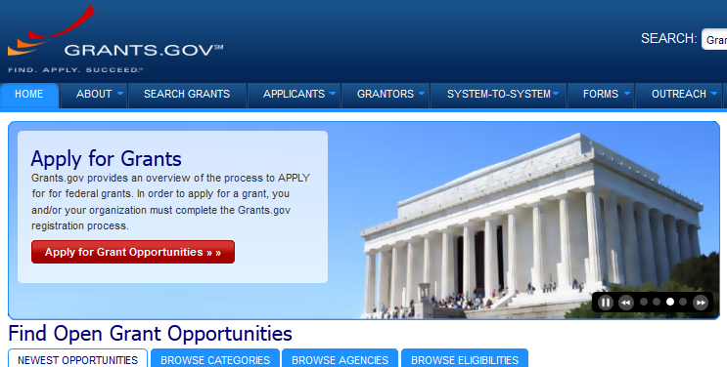
About Grants.gov

Slide 26
About Grants.gov
Grants.gov is an online, government-wide electronic application system through which all applicants must submit.
Don’t wait until immediately before your deadline; submit no later than 10 days prior to the deadline.
You are required to change your password every 60 days.
Obtain a DUNS number and register with SAM (System for Award Management) in order to use Grants.gov—allow at least 2 weeks for registration or renewal.
See www.grants.gov for more details or call 1-800-518-4726.

Slide 27
How to Apply
Step 2 of 2: Submit through NEA-GO (March 6 – 20, 2014; or August 7 – 21, 2014):
NEA Grant Application Form (including answers to narrative questions, financial info, bios)
Items to Upload (Programmatic activities list, statements of support, special items, and work samples)

Slide 28
NEA GrantsOnline™ System (NEA-GO)
You will submit the Grant Application Form and
electronically upload other items including work samples using the NEA-GO system two weeks after your Grants.gov application deadline.
Prepare these materials well in advance of the application deadline and have them ready to upload once NEA-GO becomes available to you.

Slide 29
NEA GrantsOnline™ System (NEA-GO)
Accessing the system:
Go to “Track My Application” at Grants.gov
The notes box will have a link to NEA-GO and information about when the system will be open
User Name = Grants.gov Tracking Number
Password = NEA Application Number
This info is available 2 days after you submit your SF-424 to Grants.gov (but no earlier than 10 days before the application deadline).

Slide 30
Application Tips
Please read the guidelines carefully
Be aware of the new application deadlines
The NEA does not fund general operating or seasonal support.
Your project should be a distinct selection of your annual programming activities and not cover the entirety of your seasonal offerings.
The only exception is for organizations that undertake only one activity per year, such as a festival.

Slide 31
Application Tips
BE SPECIFIC
Applications that are clear about the planned project activities do well.
An indication of repertoire to be programmed is an important part of review.

Slide 32
Application Tips
CHOOSING WORK SAMPLES
Work samples are a vital part of your proposal.
Selections should be of recent recordings (within the past two years). Check the guidelines for requirements.
They should include proposed artists and works to be performed or presented.

Slide 33
Application Tips
contact staff to receive panel feedback and advice.
Specialists are available to give you detailed panelist feedback.
Helpful for all applicants to improve future applications.
Additionally, staff is available for guidance before you submit an application.

Slide 34
Application Tips
Choosing the correct discipline
ARTS EDUCATION: projects that provide in-depth arts education knowledge and skill-building
February = Community-based projects
July = School-based projects
Contact Denise Brandenburg, 202-682-5044 or brandenburg@arts.gov
PRESENTING & MULTIDISCIPLINARY WORKS: Single discipline presenting projects should apply to that discipline

Slide 35
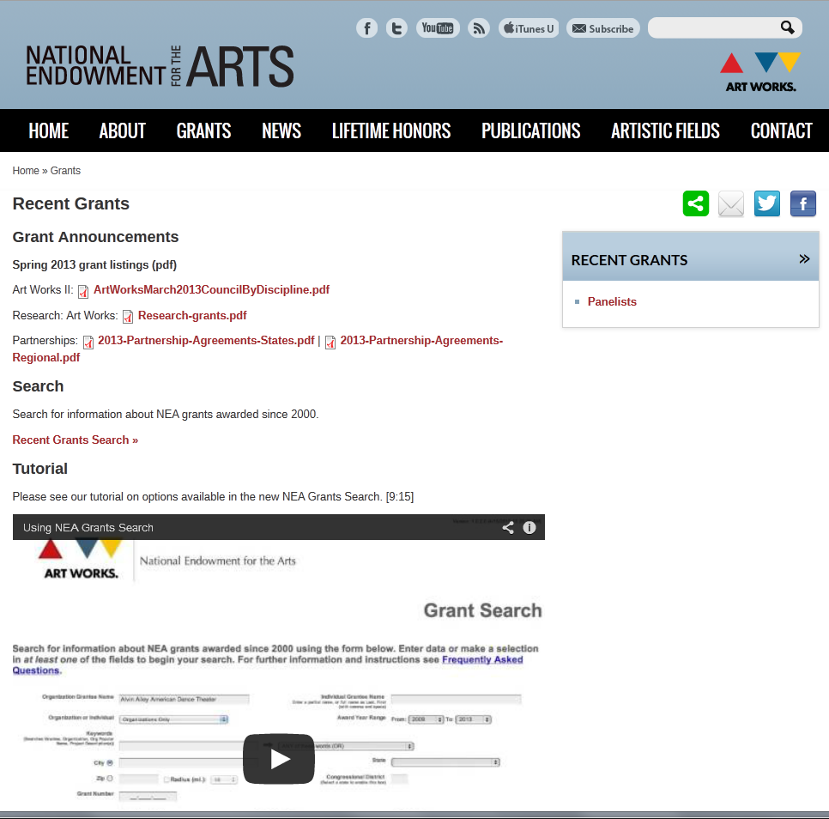
FAQs and Past Grants

Slide 36
Sample Applications
Examples of previously submitted application narratives can be found in our FOIA Reading Room at www.arts.gov.

Slide 37
Accessibility
Things to consider when planning your project:
Sign interpretation of panels or community workshops, upon request
Accessible electronic versions of print material and publications, upon request
Wheelchair accessible venues
Large-print, high contrast labeling of exhibitions
Open or closed captioning of broadcasts and educational videos

Slide 38
Reminder: New This Year
Deadlines have changed
Our website (arts.gov) has a new look
Most application materials are now submitted online via NEA-GO; see the How to Apply instructions for details
No grants will be made under $10,000
Letters of support are required
Program evaluation resources are available

Slide 39
Questions?
Apply:
http://arts.gov/grants/organizations-apply
Court Burns (organizations starting with A-L)
202-682-5590
or
burnsc@arts.gov
Anya Nykyforiak (organizations starting with M-Z)
202-682-5487
or
nykyfora@arts.gov
Katja von Schuttenbach (Jazz projects)
202-682-5711
or vonschuttenbach@arts.gov

