Slide 1
NEA Design Program
Art Works Guidelines Webinar
Jason Schupbach
Apply: http://arts.gov/grants/organizations-apply
Notes:
Hello and welcome to the NEA’s Design Program’s Art Works grant guidelines webinar. I’m joined today by Jen Hughes, Design Specialist.
You are all muted and will only be able to hear us.
We will give a brief PowerPoint presentation followed by a Q&A session. You can submit questions/comments at any time using the Q&A box below the PowerPoint. We will do our best to address as many as possible during the time we have.
Please do not use the "raise hand" button.
This webinar will be posted in the “Podcasts, Webcasts, & Webinars” section of our website in a few days so you can refer to it in the future.

Slide 2
NEA
DESIGN
ART WORKS
QUESTIONS?
Notes:
So today we’re going to talk a bit about the NEA itself, I’ll tell you about how we define design, then we’ll go through a long description of how to apply to Design Art Works, and then we’ll have time for Q + A.

Slide 3
Notes:
The National Endowment for the Arts:
is a public agency dedicated to advancing artistic
excellence, creativity, and innovation for the
benefit of individuals and communities.
awards grants to arts organizations of all sizes
across all 50 states and 6 U.S. territories.

Slide 4
arts district planning
exhibitions
publications
design education
design programming
commissions
competitions
community-wide planning and design
design for cultural spaces
technology projects
innovative design products
DESIGN
PROJECT TYPES
design festivals
historic preservation
design research
conferences
Notes:
What does the NEA mean by design?
The design field encompasses many disciplines including, but not limited to, architecture, communications and graphic design, fashion design, industrial and product design, interior design, landscape architecture, planning, universal design, rural design, and urban design. The National Endowment for the Arts recognizes design's ever-present impact on society by funding activities that encourage, preserve, and disseminate the best in American and global design.
… and a whole lot more. Here is a list of the project types you’ll see in our grant guidelines.

Slide 5
© Alaska Design Forum
Notes:
So it includes things like these Temporary installations by the Alaska Design forum

Slide 6
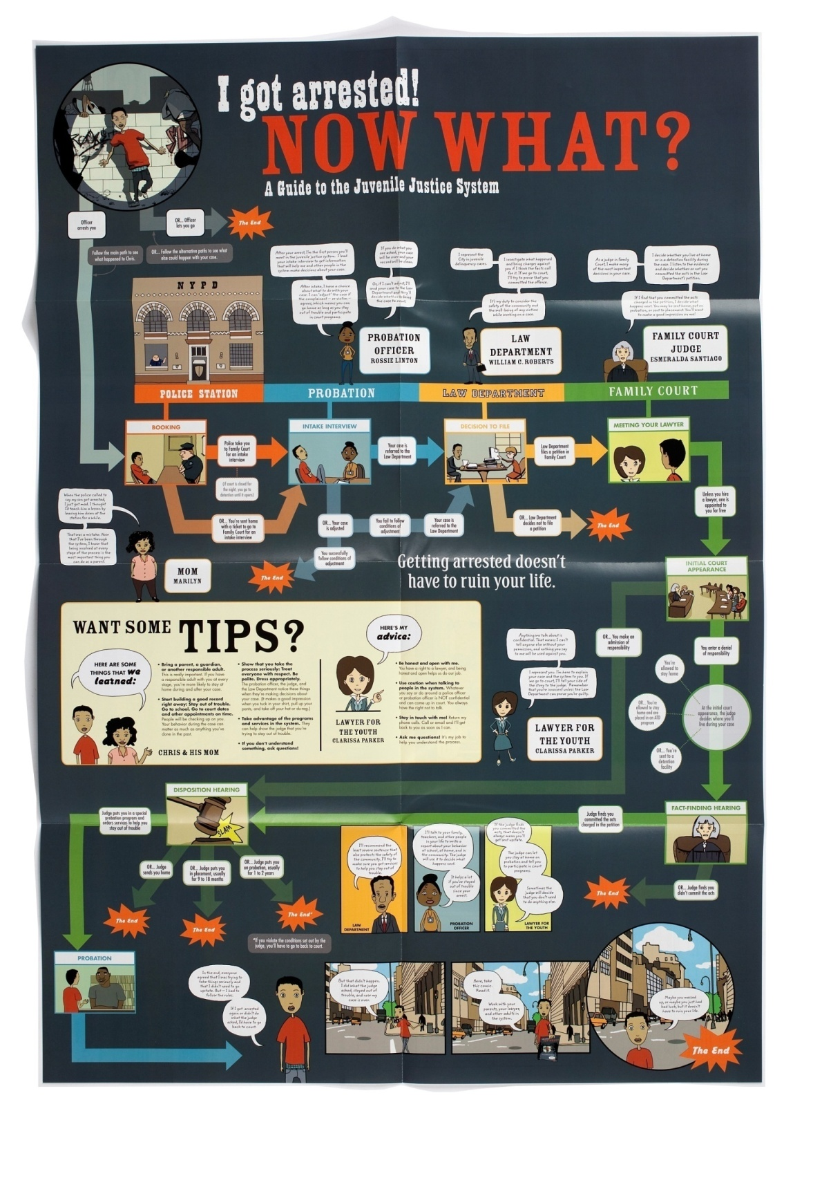
© Center for
Urban Pedagogy
Notes:
NEA funds: Graphic designs and publications

Slide 7
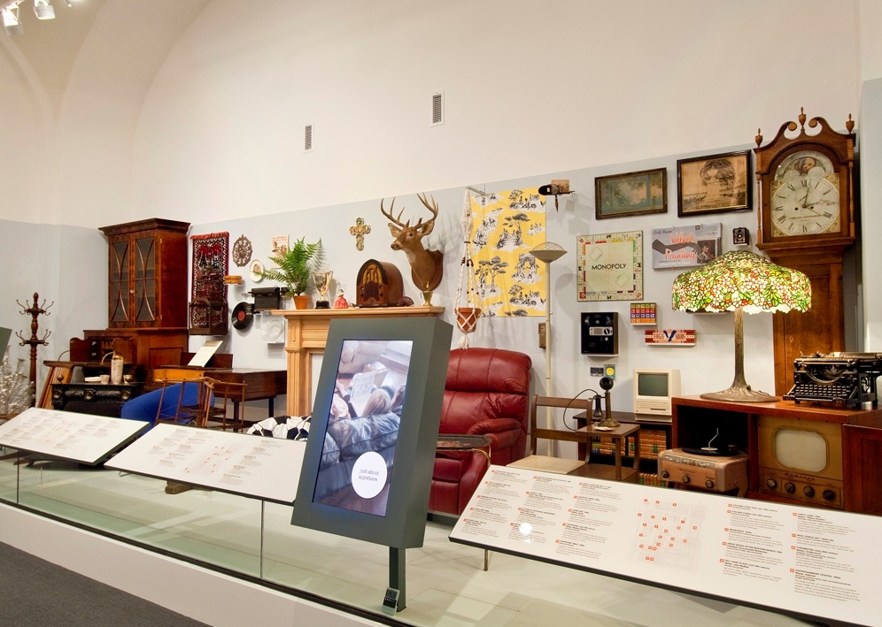
© National Building Museum
Notes:
exhibitions

Slide 8
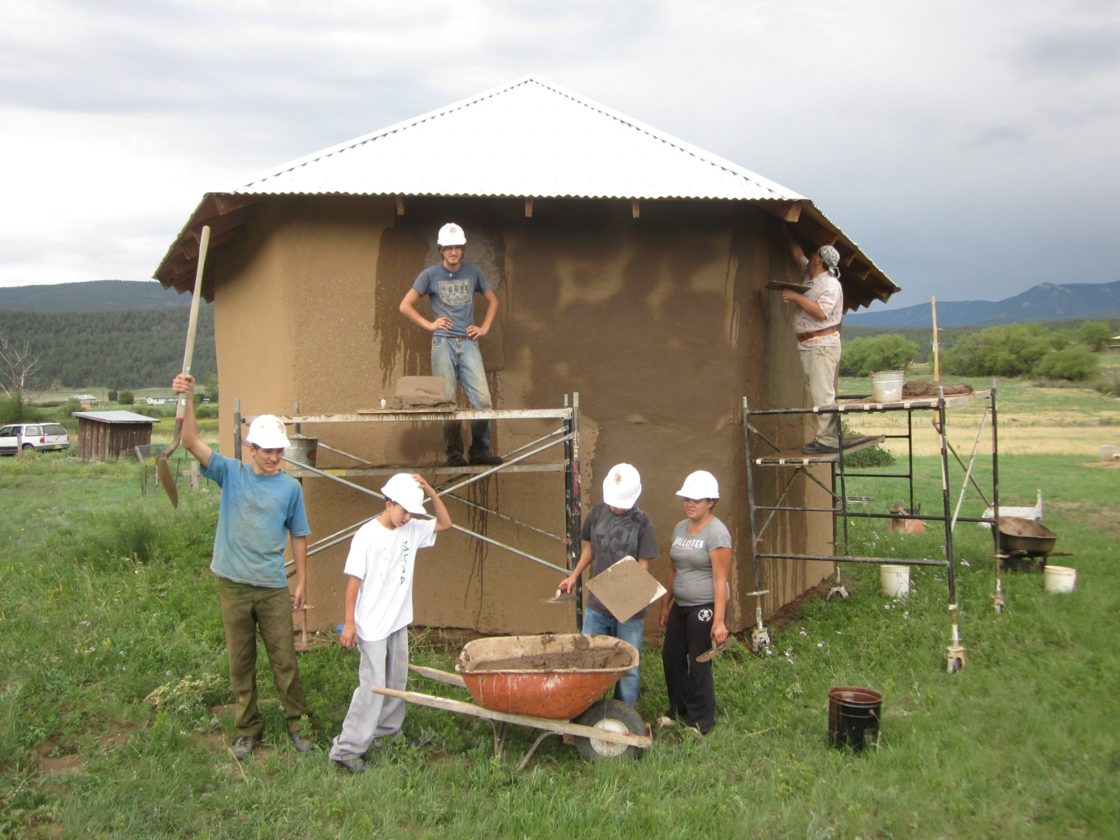
Cornerstones image
© Cornerstones Community Partnerships
Notes:
Historic preservation education and training

Slide 9
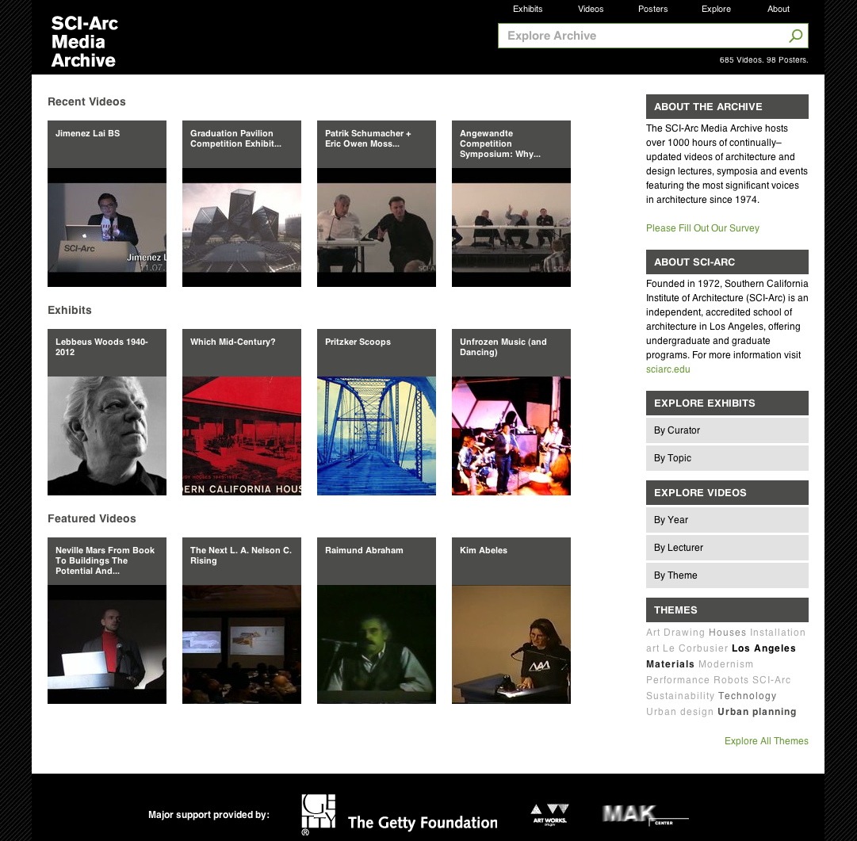
© SCI-Arc
Notes:
Archives of important design materials

Slide 10
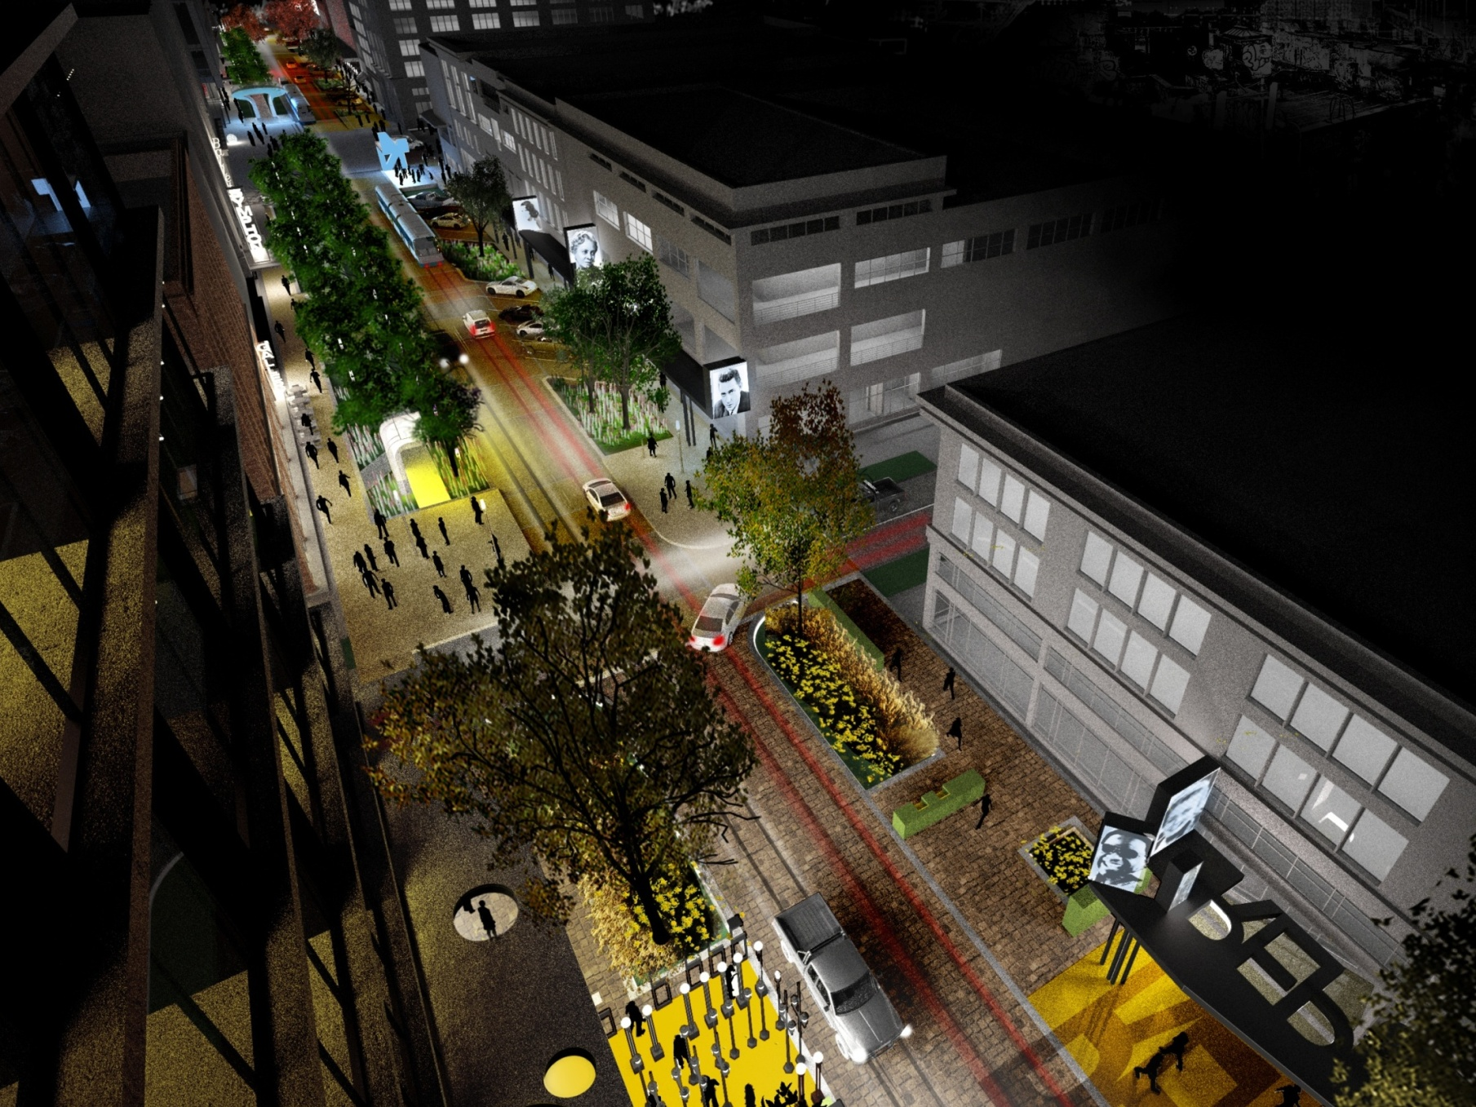
© University of Arkansas Community Design Center
Notes:
And Urban planning and design

Slide 11
ART WORKS means…
Works of art
Art works on audiences
Art is work for the artists and professionals
Notes:
So let’s jump in a bit to tell you generally about the Art works category at the agency.
Art Works the term is series of a guiding principles that are at the center of everything we do at the NEA, referring to:
The works of art themselves
The ways art works on audiences
Art is work for the artists and art professionals who make up the field

Slide 12
ART WORKS supports four outcomes…
Creation
Learning
Engagement
Livability
Notes:
The Art Works program supports Four Outcomes in its granting:
Creation: The portfolio of American Art is expanded.
Engagement: Americans throughout the nation experience art.
Learning: Americans of all ages acquire knowledge or skills in the arts.
Livability: American communities are strengthened through the arts.

Slide 13
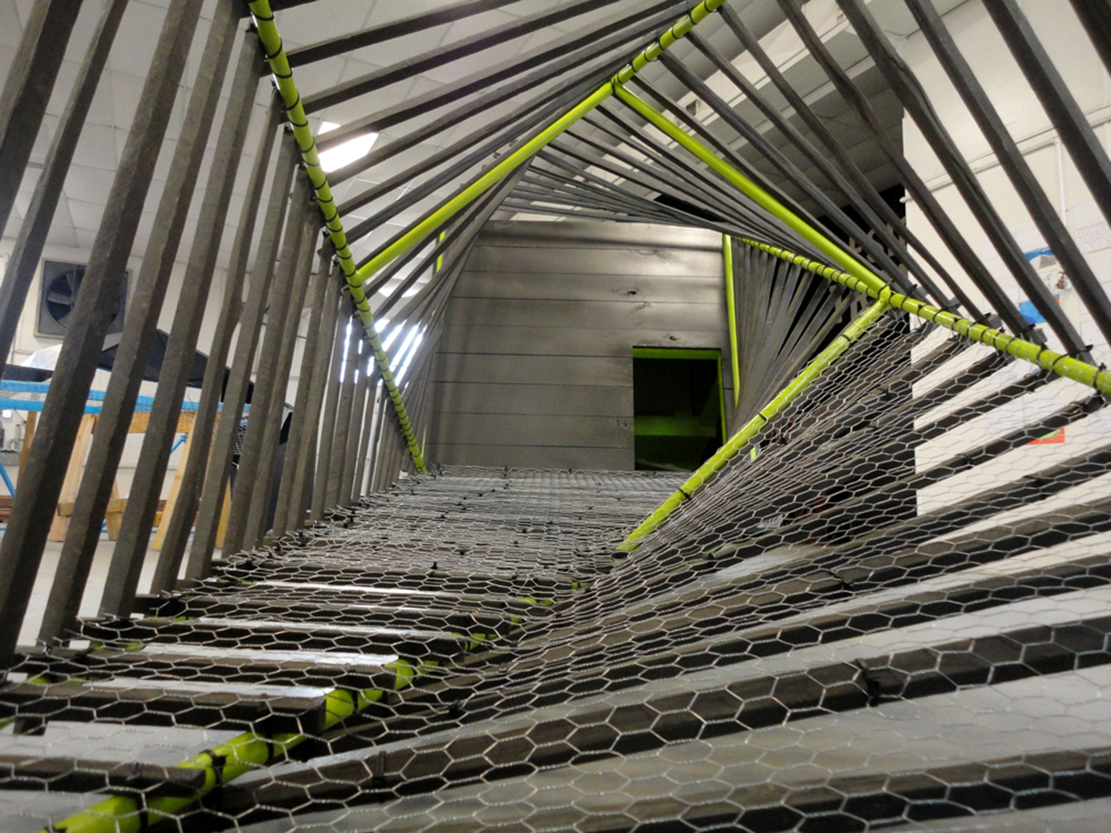
INNOVATION
© Project H Design
Notes:
Art Works grants also Encourages Innovation
Innovative projects:
Are likely to prove transformative with the potential for meaningful change
Are distinctive, offering fresh insights and new value for their fields and/or the public through unconventional solutions
Have the potential to be shared and/or emulated, or are likely to lead to other advances in the field

Slide 14
ART WORKS Eligibility Requirements
Eligible applicants are…
Nonprofit, tax-exempt 501(c)(3), U.S. organizations
Units of state or local government
Federally recognized tribal communities or tribes
with a 3-year history of programming
Notes:
To apply to art works you must meet the following eligibility requirements. Meet reporting requirements on any previous NEA awards

Slide 15
ART WORKS Application Limits
Organizations may submit only one application under the Art Works, except for:
Applicants to Media Arts (July deadline)
Applications to Our Town (January deadline)
Notes:
Organizations may submit only one application under the Art Works guidelines, with limited exceptions such as:
Parent (and Related) Organizations
Applicants to Media Arts (July deadline)
Applications to another category such as Our Town
See the guidelines for other information on application limits

Slide 16
ART WORKS Grant Amounts
Grants range from $10,000 to $100,000
Grants must be at least $10,000
Grants require a one-to-one match
Average Design grants range from $30,000 to $40,000
Notes:
Grant requests range from $10,000 to $100,000
No grants will be made for less than $10,000
One-to-one match required for project budget
Average (insert discipline name) grants range from $XX,000 to $XX,000

Slide 17
ART WORKS Does NOT Fund
General operating or seasonal support
Commercial, for-profit enterprises
Individuals
Creation of new organizations
Individual schools
Re-granting
Projects that replace arts instruction in schools
Facility construction, purchase, or renovation
Academic degrees
Notes:
General operating or seasonal support
Individuals
Individual schools
Projects that replace arts instruction provided by a classroom teacher or an arts specialist in schools
Academic degrees
Commercial, for-profit enterprises
Facility construction, purchase, or renovation
Creation of new organizations
Re-granting

Slide 18
ART WORKS Grant Review Process
Step 1: Panel Review
Step 2: National Council on the Arts
Step 3: NEA Chairman

Slide 19
ART WORKS Grant Review Criteria
Artistic Excellence
Artistic Merit
Notes:
All grants are reviewed on both their artistic excellence and artistic merit. These scores are equally weighted. The merit is really everything that you might expect a grant be reviewed on – the budget, schedule, capacity of the organization to carry the project out and the quality of the project. The excellence score is something unique to our agency, it’s the excellence of your projects artists, in most cases, designers associated with the project. It can also be the excellence of the organization doing the work or the services that they will do. All of this means that it’s very important that you make sure that your work samples and biographies of the designers associated with the project show excellence. Don’t shy away from telling us why these designers are the best people possible for your project, as appropriate.

Slide 20
ART WORKS Processing Timeline
Application
Deadline
Jul 2014
Panel Review
Fall 2014
Council Approval
Mar 2015
Award Notification
Apr 2015
Project
Start
Jun 2015

Slide 21
HOW TO APPLY TO
ART WORKS

Slide 22
Find our guidelines online at arts.gov in the
“Apply for a Grant” section.

Slide 23
Select “Grants for Organizations.”

Slide 24
Select “Art Works” to learn more about the category.
(Browse through “Key Information for Applicants” for other important information.)

Slide 25
After you read about the Art Works category, select “Design” to apply.

Slide 26
After you read about the project types supported at each deadline, select “How to Prepare and Submit an Application” (and the instructions) to get started.

Slide 27
Step 1 of 2
Submit through Grants.gov (July 24 deadline – earlier!!!)
SF-424 (Application for Federal Domestic Assistance)
This is the only item you submit through Grants.gov. If it is not successfully submitted by the deadline, you will be unable to submit your other materials in NEA-GO.
Notes:
The process is a bit different this year. Note that the initiative deadline has moved up!!!

Slide 28
About Grants.gov
Online, government-wide electronic application system through which all applicants must submit.
Don’t wait until immediately before your deadline; submit no later than 10 days prior to the deadline.
You are required to change your password every 60 days.
Obtain a DUNS number and register with SAM (System for Award Management) in order to use Grants.gov—allow at least 2 weeks for registration or renewal.
See www.grants.gov for more details or call 1-800-518-4726.

Slide 29
Step 2 of 2
Submit through NEA-GO: (August 7-21)
NEA Grant Application Form
(including answers to narrative questions, financial info, bios)
Items to Upload
(Programmatic activities list, statements of support, special items, and work samples)

Slide 30
NEA GrantsOnline™ System (NEA-GO)
You will submit the Grant Application Form and electronically upload other items using the NEA-GO system two weeks after your Grants.gov application deadline.
Prepare these materials well in advance of the application deadline and have them ready to upload once NEA-GO becomes available to you.

Slide 31
NEA GrantsOnline™ System (NEA-GO)
Accessing the system:
Go to “Track My Application” at Grants.gov
The notes box will have a link to NEA-GO and info about when the system will be open
User Name = Grants.gov Tracking Number
Password = NEA Application Number
This info is available 2 days after you submit your SF-424 to
Grants.gov (but no earlier than 10 days before the application deadline)

Slide 32
ART WORKS Application Tips
Please read the guidelines carefully
Be aware of the new application deadlines (July 24, 2014)
Remember the review criteria
(artistic excellence and artistic merit)

Slide 33
ART WORKS Application Tips
You can find access to specific review criteria at the bottom of the Art Works: Design page

Slide 34
FAQs, Past Grants, and Sample Grants
FAQs
Past Grants
Sample Grants

Slide 35
Sample ART WORKS Applications
Examples of previously submitted application narratives can be found in our FOIA Reading Room at www.arts.gov.

Slide 36
ART WORKS & Accessibility
Things to consider…
Sign interpretation
Accessible electronic versions
Wheelchair accessible venues
Large-print signs
Open/closed captioning
Notes:
Things to consider when planning your project:
Sign interpretation of panels or community workshops, upon request
Accessible electronic versions of print material and publications, upon request
Wheelchair accessible venues
Large-print, high contrast labeling of exhibitions
Open or closed captioning of broadcasts and educational videos

Slide 37
REMINDER: New This Year
Deadlines have changed
Our website (arts.gov) has a new look
Most application materials are now submitted online via NEA-GO; see the How to Apply instructions for details

Slide 38
REMINDER: New This Year
Letters of support are required
Program evaluation resources are available

Slide 39
Questions?
neadesign@arts.gov
Apply @ http://arts.gov/grants/organizations-apply

